Slide 1
UNIT 14
Influential Observations and
Variable Selection

Slide 2
Influential Observations

Slide 3
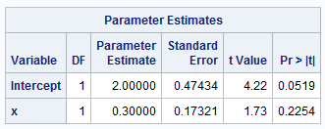
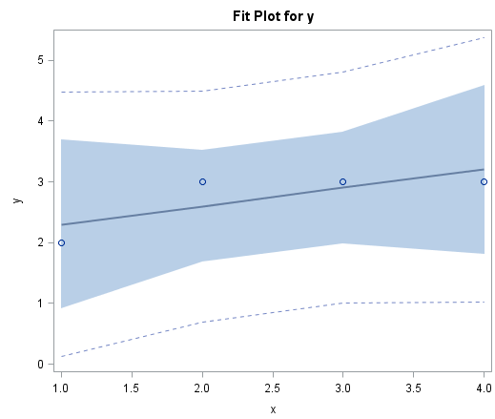
Data Set 1 (Excluded)
subject | x | y | group
1 | 1 | 2 | Exclude
2 | 2 | 3 | Exclude
3 | 3 | 3 | Exclude
4 | 4 | 3 | Exclude
5 | 1 | 2 | Include
6 | 2 | 3 | Include
7 | 3 | 3 | Include
8 | 4 | 3 | Include
9 | 30 | 50 | Include

Slide 4
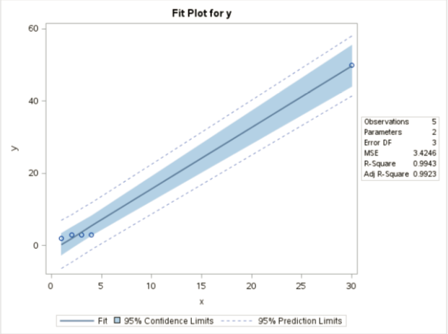
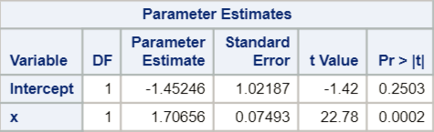
Data Set 2 (Included)
subject | x | y | group
1 | 1 | 2 | Exclude
2 | 2 | 3 | Exclude
3 | 3 | 3 | Exclude
4 | 4 | 3 | Exclude
5 | 1 | 2 | Include
6 | 2 | 3 | Include
7 | 3 | 3 | Include
8 | 4 | 3 | Include
9 | 30 | 50 | Include

Slide 5
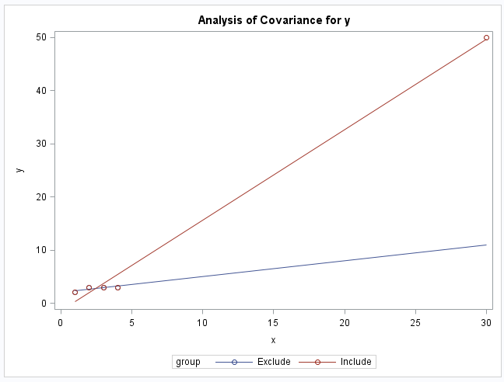
Excluded vs. Included

Slide 6
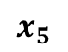
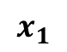
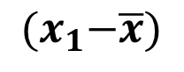
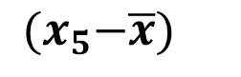
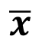
The Idea of Leverage
$$x_{5}$$
$$x_{1}$$
$$\overline{x}$$
$${(x}_{1}−\overline{x})$$
$${(x}_{5}−\overline{x})$$

Slide 7
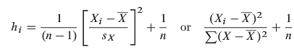
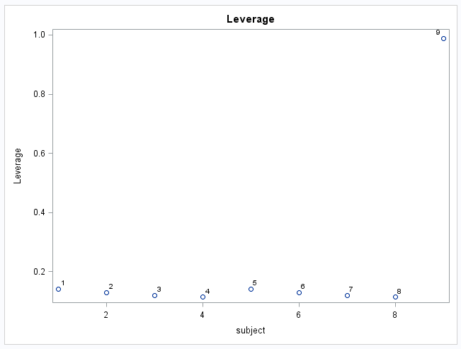
Definition of Leverage (one explanatory variable)
leverage is a function of the distance from X_{i} to X_{bar}, in units of standard deviations
leverage is a function of the proportion of the total sum of squares of the explanatory variable contributed by the i^{th} case
x_{bar}
x_{i}
*combining all 9 pts into one dataset.

Slide 8
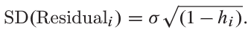
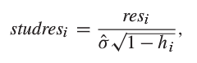
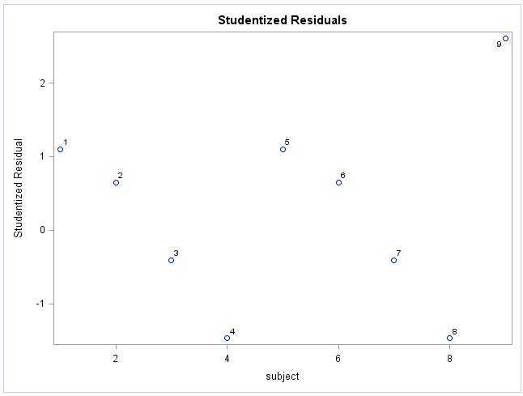
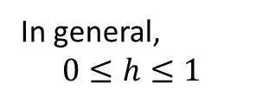
Studentized Residual
In general,
$$0≤h≤1$$
We “standardized” the normally distributed residual, so only 5% of studres_{i} should be more extreme than +-2.

Slide 9
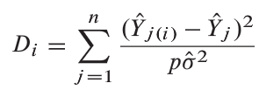
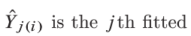
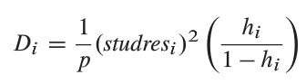
Cook’s Distance (D)

Slide 10
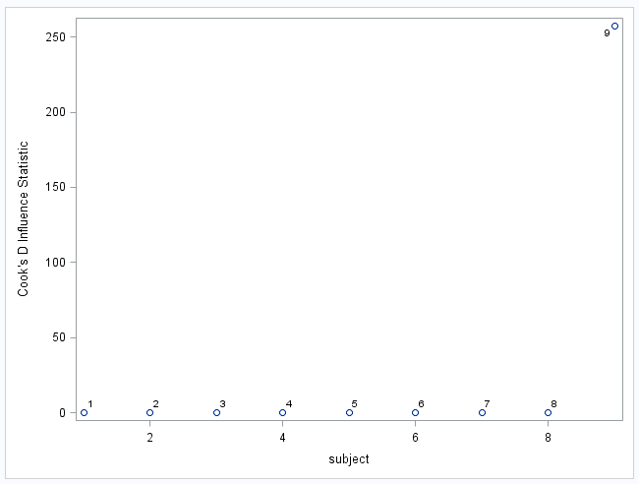
Cook’s D!
A Blend of Both!!!
D > 1 or D > 4/n might be influential.
residual
leverage

Slide 11
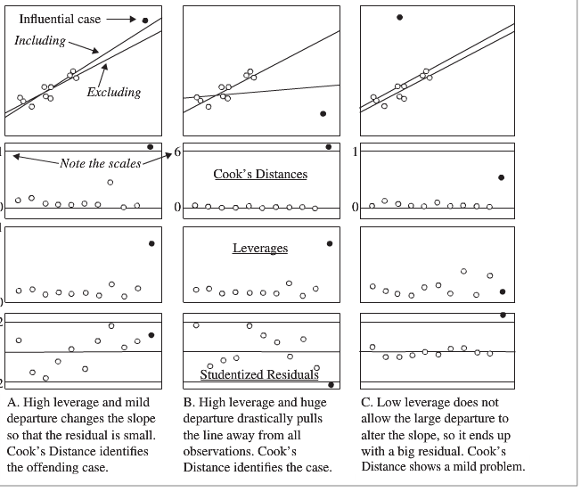
Studentized Residuals, Leverage and Cook’s D!

Slide 12
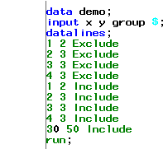
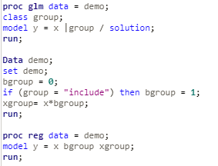
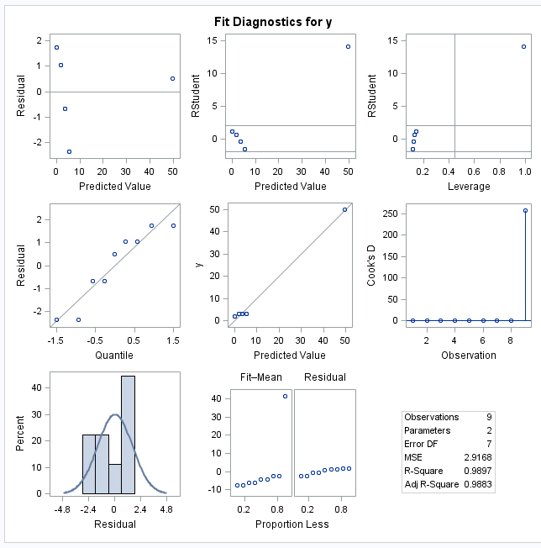
PROC REG or GLM

Slide 13
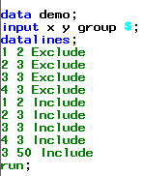
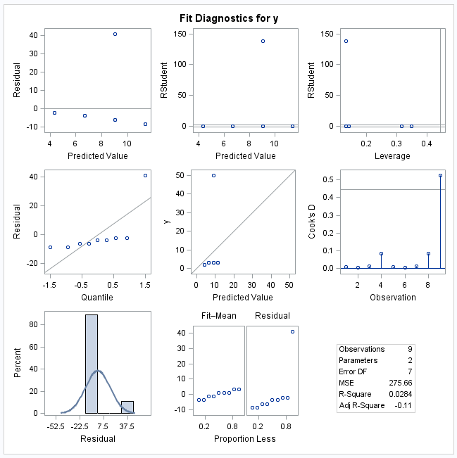
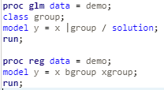
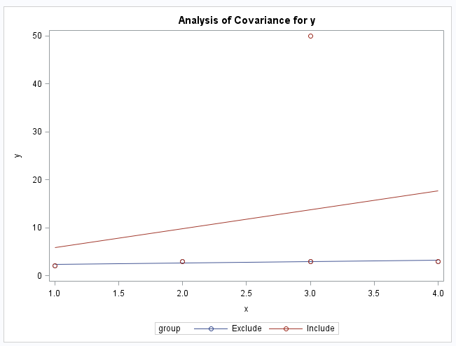
Proc Reg or GLM

Slide 14
Variable Selection

Slide 15
Steps in Multiple Regression
Plot the Data.
Develop a Tentative Model(s).
Using the Question(s) of Interest (QOI)
Accounting for Confounders
Accounting for Relationships (X², X³, etc.)
Fit the Model(s).
Evaluate Residual Plots.
Constant SD
Normality and zero mean
Identify Any Influential Observations
Perform validation.
Answer the Question of Interest.

Slide 16
Variable Selection Techniques
Forward Selection
Backward Elimination
Stepwise Regression
Best Subset Regression
Others techniques will be shown in other courses

Slide 17
Forward Selection
Initialize process to set the current model to include only the intercept. (This step is theoretical, only for flowchart purposes; no steps need to be taken.)
Choose a threshold p-value (p_{Enter}), perhaps 0.15.
For each of the predictors not in the current model, build a new model consisting of the current model plus one predictor.
Do any of the predictors not in the current model have p-values less than p_{Enter}?
yes
Choose the predictor with the lowest p-value to become a part of the current model.
no
Stop. The best model is the current model.

Slide 18
Backward Elimination
Initialize process to set the current model to include ALL candidate predictors. (This step is theoretical, only for flowchart purposes; no steps need to be taken.)
Choose a threshold p-value (p_{Remove}), perhaps 0.15.
Run the regression (fit the model) with the predictors in the current model.
Do any of the predictors in the current model have p-values greater than p_{Remove}?
yes
Choose the predictor with the highest p-value to be removed from the current model.
no
Stop. The best model is the current model.

Slide 19
Step-Wise Regression

Slide 20
Example: Cement data
Response y: heat evolved in calories during hardening of cement on a per gram basis
Predictor x₁: % of tricalcium aluminate
Predictor x₂: % of tricalcium silicate
Predictor x₃: % of tetracalcium alumino ferrite
Predictor x₄: % of dicalcium silicate

Slide 21
Example: Cement data

Slide 22
Stepwise regression: the idea
Start with no predictors in the “stepwise model.”
At each step, enter or remove a predictor based on t-tests.
Stop when no more predictors can be justifiably entered or removed from the stepwise model.

Slide 23
Stepwise regression: Preliminary steps
Specify a P-value-to-Enter (p-value_{E} = 0.15) significance level.
Specify a P-value-to-Remove (p-value_{R} = 0.15) significance level.

Slide 24
Example: Cement data
Note strong correlation between x2 and x4.

Slide 25
Predictor Coef SE Coef T P
Constant 81.479 4.927 16.54 0.000
x1 1.8687 0.5264 3.55 0.005
Predictor Coef SE Coef T P
Constant 57.424 8.491 6.76 0.000
x2 0.7891 0.1684 4.69 0.001
Predictor Coef SE Coef T P
Constant 110.203 7.948 13.87 0.000
x3 -1.2558 0.5984 -2.10 0.060
Predictor Coef SE Coef T P
Constant 117.568 5.262 22.34 0.000
x4 -0.7382 0.1546 -4.77 0.001

Slide 26
Predictor Coef SE Coef T P
Constant 103.097 2.124 48.54 0.000
x4 -0.61395 0.04864 -12.62 0.000
x1 1.4400 0.1384 10.40 0.000
Predictor Coef SE Coef T P
Constant 94.16 56.63 1.66 0.127
x4 -0.4569 0.6960 -0.66 0.526
x2 0.3109 0.7486 0.42 0.687
Predictor Coef SE Coef T P
Constant 131.282 3.275 40.09 0.000
x4 -0.72460 0.07233 -10.02 0.000
x3 -1.1999 0.1890 -6.35 0.000

Slide 27
Predictor Coef SE Coef T P
Constant 71.65 14.14 5.07 0.001
x4 -0.2365 0.1733 -1.37 0.205
x1 1.4519 0.1170 12.41 0.000
x2 0.4161 0.1856 2.24 0.052
Predictor Coef SE Coef T P
Constant 111.684 4.562 24.48 0.000
x4 -0.64280 0.04454 -14.43 0.000
x1 1.0519 0.2237 4.70 0.001
x3 -0.4100 0.1992 -2.06 0.070

Slide 28
Predictor Coef SE Coef T P
Constant 52.577 2.286 23.00 0.000
x1 1.4683 0.1213 12.10 0.000
x2 0.66225 0.04585 14.44 0.000

Slide 29
Predictor Coef SE Coef T P
Constant 71.65 14.14 5.07 0.001
x1 1.4519 0.1170 12.41 0.000
x2 0.4161 0.1856 2.24 0.052
x4 -0.2365 0.1733 -1.37 0.205
Predictor Coef SE Coef T P
Constant 48.194 3.913 12.32 0.000
x1 1.6959 0.2046 8.29 0.000
x2 0.65691 0.04423 14.85 0.000
x3 0.2500 0.1847 1.35 0.209

Slide 30
Predictor Coef SE Coef T P
Constant 52.577 2.286 23.00 0.000
x1 1.4683 0.1213 12.10 0.000
x2 0.66225 0.04585 14.44 0.000

Slide 31
Stepwise Regression: y versus x1, x2, x3, x4
Alpha-to-Enter: 0.15 Alpha-to-Remove: 0.15
Response is y on 4 predictors, with N = 13
Step 1 2 3 4
Constant 117.57 103.10 71.65 52.58
x4 -0.738 -0.614 -0.237
T-Value -4.77 -12.62 -1.37
P-Value 0.001 0.000 0.205
x1 1.44 1.45 1.47
T-Value 10.40 12.41 12.10
P-Value 0.000 0.000 0.000
x2 0.416 0.662
T-Value 2.24 14.44
P-Value 0.052 0.000
S 8.96 2.73 2.31 2.41
R-Sq 67.45 97.25 98.23 97.87
R-Sq(adj) 64.50 96.70 97.64 97.44
C-p 138.7 5.5 3.0 2.7

Slide 32
Caution about stepwise regression!
Do not jump to the conclusion …
that all the important predictor variables for predicting y have been identified, or
that all the unimportant predictor variables have been eliminated.

Slide 33
Caution about stepwise regression!
Many t-tests are conducted in a stepwise regression procedure.
The probability is high …
that we included some unimportant predictors
that we excluded some important predictors

Slide 34
Drawbacks of stepwise regression
The final model is not guaranteed to be optimal in any specified sense.
Stepwise regression is sensitive to models with high multicollinearity.
The procedure yields a single final model, although in practice there are often several equally good models.
It doesn’t take into account a researcher’s knowledge about the predictors.

Slide 35
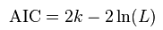
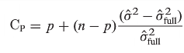
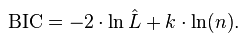
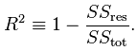
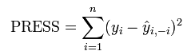
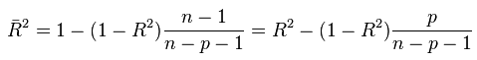
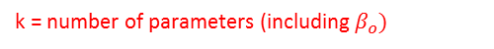
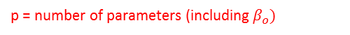
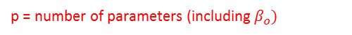
Variable Selection Criteria
There are many other criteria to perform variable selection with besides the F or t statistics!
Here are a few:
Smaller the Better:
Smaller the better / Closest to p.
k = number of parameters (including $β_{o})$
p = number of parameters (including $β_{o})$
$$AIC=n\log\left(\frac{SSRes}{n}\right)+2 (p+1)$$
$$Cp=\frac{SSRes}{{\hat{σ}}_{Full}^{2}}−n+2p$$
Larger the Better:
BIC$=n\log\left(\frac{SSRes}{n}\right)+\log\left(n\right)(p+1)$
Assuming no overfit.
p = number of parameters (including $β_{o})$
p = number of predictors
L = Max(likelihood function), will learn in later course.

Slide 36
Possible Objectives When There Are Many Potential Explanatory Variables
Adjusting for a Large Set of Explanatory Variables
Fishing for Explanation
Prediction
Question of Interest

Slide 37
Example 2: SAT Analysis… QOI and Data
QOI: A common discussion in education is if, and to what extent, spending money on students is significantly associated with increased test scores. We would like to conduct an analysis to quantify any evidence that the amount of money spent on each student (Expend) is associated with an increase in the average SAT score for that state after accounting for possible confounding factors that have been recorded in the data set.
The Data (50 observations … 1 for each state):
SAT: average SAT score for the state
TAKERS: % of the state’s students that take the test
INCOME: Median income of families in the state
YEARS: average number of years students received formal education in social studies, natural sciences and humanities
PUBLIC: percentage of test takers that attend public schools
EXPEND: amount of money in $100s that the state spends on each student
RANK: median percentile rank of the students in their secondary school.

Slide 38
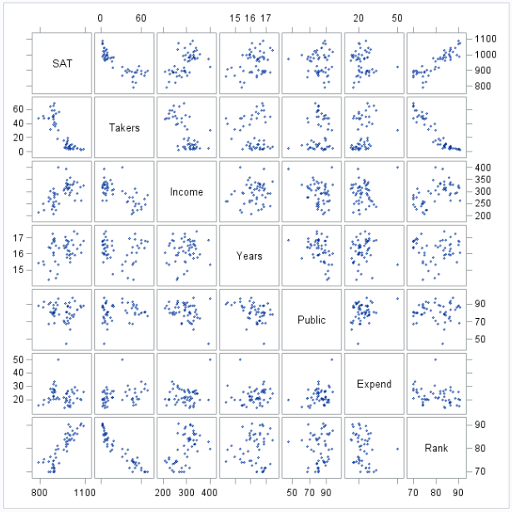
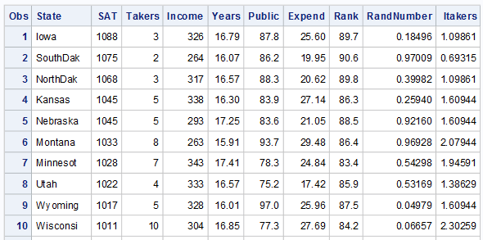
Example 2: SAT Analysis … A look at the data.
First 10 rows!

Slide 39
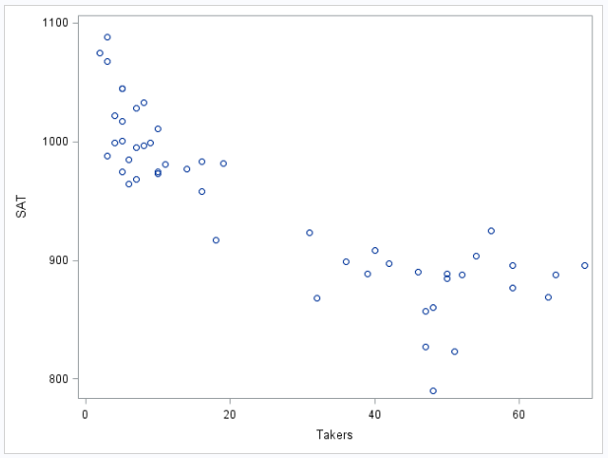
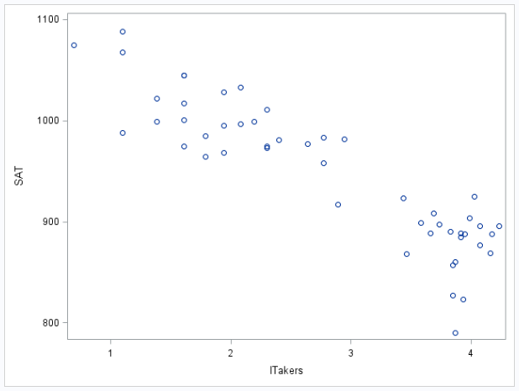
Example 2: SAT Analysis … Tentative Model
Judging from the scatter plot, it looks like takers may need to be transformed to achieve a linear relationship with SAT scores.
We will try a log transform.
Takers
Log(Takers)
Our strategy here will be to try out various variable selection techniques to select those variables that may be associated with SAT score. Our variable of interest (Expend) will be excluded from this process and then added in later after the potential confounders have been identified. NOTE THAT WE HAD TO NOTICE THE NECESSARY TRANSFORMATION AND THAT THE VARIABLE SELECTION TECHNIQUE WOULD HAVE MISSED THIS CRUCIAL STEP.

Slide 40
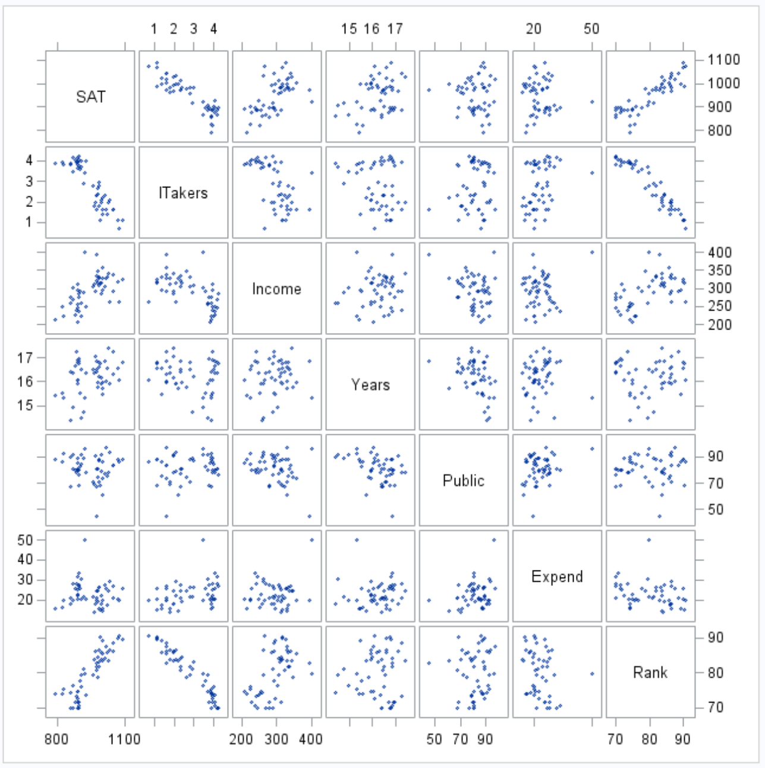
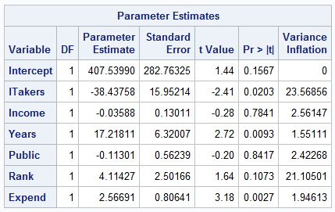
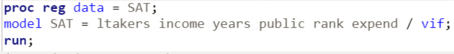
Example 2: SAT Analysis … A look at the VIFs.
Tests multicollinearity.
Guideline: VIF>10 is a red flag

Slide 41
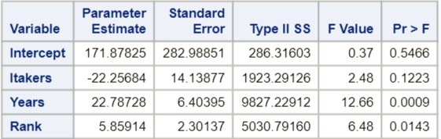
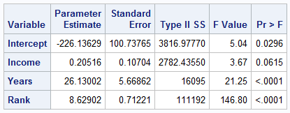
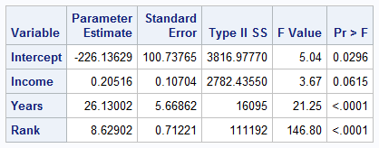
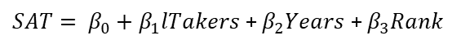
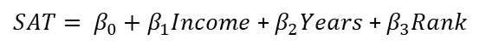
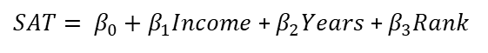
Example 2: SAT Analysis … Model Selection (adj R²)
Forward
$SAT= β_{0}+β_{1}lTakers$+ $β_{2}Years$ + $β_{3}Rank$
Adj r² = .8454
Backward
$SAT= β_{0}+β_{1}Income$+ $β_{2}Years$ + $β_{3}Rank$
Adj r² = .8491
Stepwise
$SAT= β_{0}+β_{1}Income$+ $β_{2}Years$ + $β_{3}Rank$
Adj r² = .8491

Slide 42


Example 2: SAT Analysis … Check Residuals / Assumptions
$SAT= β_{0}+β_{1}Income$+ $β_{2}Years$ + $β_{3}Rank$
Judging from the scatter plots, there is no evidence against normality of SAT scores conditional on fixed values of income, years and rank.
Judging from the scatter plots, there is no evidence against constant variance of SAT scores across values of income, years and rank.
Judging from the matrix of scatter plots, there is no evidence against the assumption of linear trend between income, years and rank and SAT scores.
We will assume all states’ SAT scores are independent.
Note the multicollinearity has been resolved as well. (VIFS < 4).

Slide 43


Example 2: SAT Analysis: Influential Observations
There do not appear to be any observations with both high leverage and high residual, nor do there appear to be any observations with notable Cook’s D. For this reason, no single observation appears to be extremely influential on its own.

Slide 44


Example 2: SAT Analysis: Add Expenditure Back in.
Clearly, the expenditure each state spends on its students (Expend) has a significant p-value, and judging from the residual plots, there does not seem to be significant evidence against the assumptions mentioned earlier. However, there does appear to be an influential point that has both very high leverage and residual as well as high Cook’s D.

Slide 45


Example 2: SAT Analysis: Influential Point
Clearly, Alaska has an elevated expenditure and the thought is that it is colder in Alaska and thus a greater budget is needed to heat the school. Thus, those dollars are being spent on students but not on instruction. We will delete this observation.

Slide 46



Example 2: SAT Analysis: Without Alaska
Clearly, the expenditure each state spends on its students (Expend) has a significant p-value and judging from the residual plots, there does not seem to be significant evidence against the assumptions mentioned earlier. After the exclusion of Alaska, there no longer appears to be an overly influential point. (It is important to note here that we didn’t delete Alaska because it was influential but because it was not a part of the population that we were interested in. That is, we have reason to believe that its relationship between SAT and expenditure is different than that of the other 49 states.)

Slide 47

Example 2: SAT Analysis: Conclusion
After accounting for all other possible confounders (that we measured), and holding them fixed, we estimate that for each additional $100 spent on a student in the U.S. (excluding Alaska), his or her estimated SAT score increases 3.38514 points (p-value from MLR < .0001). A 95% confidence interval is (1.82, 4.95) points.

Slide 48



Example 2: SAT Analysis: Conclusion
The original paper was able to use race, gender and the square root of the percent of takers in the model and produced considerably different rankings. However, with this model we obtain a set of rankings after having accounted for the average income of the state, the number of years student have taken core courses, the median rank of students that took the test and the amount of money spent on students in that state.

Slide 49
BEST SUBSET REGRESSION
Best subsets regression:
Select the subset of predictors that does the best at meeting some well-defined objective criterion.

Slide 50
MALLOW’s CP
Mathematically: E(C_{p}) = p for a model with no overfit. For this reason the model with the C_{p} closest (smallest) to p is preferred. Note: ‘p’ is the number of parameters (including the intercept) in the model.
For linear regression, the C_{p} statistic has been shown to be equivalent to the AIC.

Slide 51


Fishing for Explanation

Slide 52

Cp Plot

Slide 53

Residuals / Influential Points: lTakers, Years, Expend, Rank

Slide 54
Conclusion
One possible subset of the variables that explain the variation in SAT scores well (Cp = 4.0312, R² = .9107) are the lTakers, Rank, Years, and Expenditure variables.

Slide 55
Often Used Together
$SAT= β_{0}+β_{1}Income$+ $β_{2}Years$ + $β_{3}Rank\text{+ }β_{4}Expend$
Adj R²: .9025 Cp = 8.04
$SAT= β_{0}+β_{1}lTakers$+ $β_{2}Years$ + $β_{3}Rank\text{+ }β_{4}Expend$
Adj R²: .8821 Cp = 4.03
The model with lTakers, Years, Expend and Rank looks to be have a smaller Cp statistic although the Income, Years, Rank Expend has a greater adjusted R². In addition, it can be argued that lTakers and Rank look to be highly collinear and thus may be redundant, therefore providing additional support for the top model.
At this point, it is up to the researchers and / or the experts to weigh the pros and cons of each model. For our QOI, the top model seems to be a better choice since it accounts for Income as a possible confounder and is backed up by our previous analysis. If the goal of the regression is to predict, you may not care about confounders or multicollinearity as much and may find in favor of the second model.
Finally, Cross Validation Techniques, AIC, BIC and SBC and other criteria are other valuable tools to help us decide between candidate models.

Slide 56
Variable Selection With Proc GLMselect.

Slide 57



Variable Selection With Proc GLMselect.

Slide 58






Model Comparison Using AIC/BIC/SBC
$SAT= β_{0}+β_{1}Income$+ $β_{2}Years$ + $β_{3}Rank\text{+ }β_{4}Expend$
$SAT= β_{0}+β_{1}lTakers$+ $β_{2}Years$ + $β_{3}Rank\text{+ }β_{4}Expend$
It is clear after this further analysis that there is strong evidence that the model with lTakers instead of Income is potentially a better model to assess the effect on expenditure after accounting for other variables.

Slide 59
Appendix

Slide 60


Prediction

Slide 61


Don’t Forget to Check the Residuals!

Slide 62

Sample problem
For the next problem you will have to remember your reading on the Blood-Brain Barrier problem. It is a case study in Chapter 12.

Slide 63

AIC v. BIC

Slide 64

Proc Reg Selection Options

Slide 65

Proc Reg Selection Options
http://support.sas.com/documentation/cdl/en/statug/63033/HTML/default/viewer.htm#statug_reg_sect030.htm

Slide 66
Cross Validation
External Cross Validation
Internal Cross Validation

Slide 67
Cross Validation
R² will always increase with respect to the data set we fit the model with (training set) … therefore the MSE will always decrease on this set as well.
Can’t check model complexity with the training set.... But we could if we had another data set (test set).
But we don’t have a test set!
Or do we?
Break up the dataset we have into a smaller data set to fit the data (training set) and use the rest as a test set!
Training
Training
Test
Our Data Set

Slide 68
Two Types of Cross Validation
1. External Cross Validation
2. Internal Cross Validation

Slide 69
External Cross Validation: SAS Proc glmselect
Training
Test
data deg2reg;
input X Y;
datalines;
0.5 2.162803
1 -2.732728
1.5 -4.909935
2 -7.143579
2.5 -10.244069
3 -7.393485
3.5 -11.577039
4 -11.335592
4.5 -11.870248
5 -14.012744
5.5 -14.396186
6 -11.117686
6.5 -14.393506
7 -12.918408
7.5 -12.11928
8 -12.177728
8.5 -10.488212
9 -8.907172
9.5 -10.683296
10 -8.373729
;
data deg2reg;
set deg2reg;
X2 = X**2;
X3 = X**3;
X4 = X**4;
X5 = X**5;
X6 = X**6;
X7 = X**7;
X8 = X**8;
X9 = X**9;
X10 = X**10;
X11 = X**11;
X12 = X**12;
X13 = X**13;
X14 = X**14;
X15 = X**15;
X16 = X**16;
X17 = X**17;
;
data test;
input X Y;
datalines;
0.5 1.408662
1 -4.03821
1.5 -5.367689
2 -5.299756
2.5 -9.363149
3 -7.603961
3.5 -9.708383
4 -11.026383
4.5 -10.830696
5 -12.650045
5.5 -13.064715
6 -14.168313
6.5 -13.300585
7 -12.033283
7.5 -12.670502
8 -13.489878
8.5 -11.35686
9 -11.349835
9.5 -8.546844
10 -7.332064
;
data test;
set test;
X2 = X**2;
X3 = X**3;
X4 = X**4;
X5 = X**5;
X6 = X**6;
X7 = X**7;
X8 = X**8;
X9 = X**9;
X10 = X**10;
X11 = X**11;
X12 = X**12;
X13 = X**13;
X14 = X**14;
X15 = X**15;
X16 = X**16;
X17 = X**17;
;
SAS OPTION FOR proc glmselect https://support.sas.com/documentation/cdl/en/statug/63033/HTML/default/viewer.htm#statug_glmselect_sect010.htm

Slide 70




External Cross Validation: SAS Proc glmselect

Slide 71


External Cross Validation: SAS Proc glmselect
Note from the last slide: Both selection procedures selected the same model but here we see that the ASE (Test) has increased indicating evidence of overfitting in the test data. For this reason we may want to select the model with only X and X2.

Slide 72



External Cross Validation: SAS Proc glmselect
The
JUMP
Here we clearly see the evidence of the overfitting as the Test ASE increases then waivers then increases again. We are most interested in the big jump from X2 to X3.

Slide 73
Internal (K-Fold) Cross Validation
›Since data are often scarce, there might not be enough to set aside for a test sample
›To work around this issue k-fold CV works as follows:
1. Split the sample into k subsets of equal size
2. For each “fold” estimate a model on all the subsets except one
3. Use the left out subset to test the model, by calculating a CV metric of choice
4. Average the CV metric across subsets to get the CV error
›This has the advantage of using all data for estimating the model, however finding a good value for k can be tricky

Slide 74
Internal (5-Fold) Cross Validation
Data Set
1
2
3
4
5
TRAINING
TEST
FIT STAT
1
2
3
4
5
ASE 1
5
2
3
4
1
ASE 2
1
5
3
4
2
ASE 3
1
2
5
4
3
ASE 4
1
2
3
5
4
ASE 5
CV PRESS:
SUM O R AVERAGE

Slide 75

5-Fold Cross Validation: Example

Slide 76



5-Fold Cross Validation: Example

Slide 77





SAT Example: External CV
Note: There are only 49 observations and thus there are probably not enough observations to get a good estimate of coefficients and ASE(Test). Not enough information for external cross validation to be reliable.

Slide 78





SAT Example: Internal CV
Note: Internal CV uses all the data at one point or another in the training data and in the test data… can be used with large data sets but should be used with smaller ones.

Slide 79


Compare … on same data.!

Slide 80
Cross Validation
R

Slide 81
Evaluating / Validating Models
Adjusted R² –
Higher is Better – it is a derivative of R² … the amount of variation explained by the model.
Mean Square Prediction Error (MSPE) -
Lower is better. It is a statistic that is a measure of the distance the prediction are from the actual value value … again smaller distance measure is better.

Slide 82









Cross Validation
Training Set
Test Set
MODEL
$$MSPE= \frac{\sum_{i=1}^{n}{{(x_{i}−{\tilde{x}}_{i})}^{2}}}{n}$$
$$x_{i}$$
$${\tilde{x}}_{i}$$

Slide 83




How to Choose the Train and Test Sets?
Things to Consider:
General guidance is to use 10 observations per parameter you are estimating.
Select observations to training and test sets randomly to protect against bias.
General rule is about ¾ Training and ¼ Test.

Slide 84
Putting it All Together: Steps in Cross Validation
Divide the data set with responses into a ”Training Set” and a “Test Set”.
Train a model on the Training Set.
Generate prediction using this model for the Test Set explanatory variables.
Find the MSPE using the predictions and the actual values from the Test Set.
Repeat 2 – 4 for competing models.
Compare MSPEs of Competing Models.

Slide 85
Putting it All Together!
Divide the data set with responses into a ”Training Set” and a “Test Set”.

Slide 86
Putting it All Together!
2. Train a model on the Training Set.

Slide 87

Putting it All Together
3. Generate prediction using this model for the Test Set explanatory variables.

Slide 88


Putting it All Together
4. Find the MSPE using the predictions and the actual values from the Test Set.
or

Slide 89



Putting it All Together
5. Repeat 2 - 4 for competing models.

Slide 90
Putting it All Together
6. Compare MSPEs of Competing Models.
Model | MSPE | Adj R2
Model 1 | 19.09 | .224
Model2 | 15.59 | .1576

